Slide 1
Dr. Neeraj Kumar Pandey CSE Deptt. DITU neeraj.pandey@dituniversity.edu.in
Introduction to C#

Slide 2

INDEX
Introduction to C#.
Why .NET ?
Differences between C++ and C#.
C# Program Structure & first program.
Execution of C# Program.
Adding Comments.
Using Aliases for namespace.

Slide 3
Introduction to C#
C# is a simple, modern object oriented programming language developed by Microsoft .NET initiative led by Anders Hejlsberg.
C# is very much based on C and C++.
It is approved by European Computer Manufacturers Association (ECMA) and International Standards Organization (ISO).
It is component oriented.
It is easy to learn.
It is a structured language.
It produces efficient programs.
It can be compiled on a variety of computer platforms.
It is a part of .Net Framework.

Slide 4
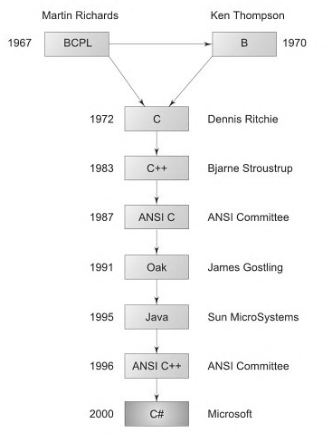
Why C# ?
It is derived from C and C++.
Major parts of .NET framework are
coded in C#.
C# is simple.
C# is modern.
C# is object oriented.
C# is powerful and flexible.
C# is modular.
Interoperable.
Versionable.

Slide 5
C++ Vs. C#
C++
C#
C++ is a general purpose, case-sensitive, free-form programming language that supports object-oriented, procedural and generic programming.
In C++, multiple inheritance is possible through class.
In C++, memory management is handled manually.
In C++, pointers can be used anywhere in a program.
C++ programming is based on OOPs concept.
C++ is a programming language that runs on all platforms.
C++ programming can be used to create console applications.
C# is pronounced as "C-Sharp". It is an object-oriented programming language provided by Microsoft that runs on .Net Framework.
In C#, multiple inheritance is not possible through class.
In C#, memory management is handled automatically.
In C#, pointers can be used only in unsafe mode.
C# programming is based on Component and OOPs concept.
C# is a programming language that rarely used outside Windows.
C# programming can be used to create console applications, Windows applications, Mobile applications, etc.

Slide 6
C# Program Structure & first program.
C# consist of following things
Namespace declaration.
A Class.
Class methods.
Class attributes.
The Main method.
Statements and Expressions.
Comments.

Slide 7
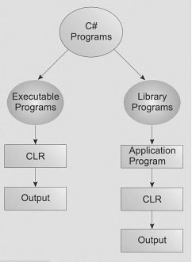
C# Program Structure & First program.
C# used to develop two categories of programs.
Executable application programs .
Executable programs are written to carry out certain tasks and require the method Main in one of the class.
2. Component libraries.
Component libraries do not require a Main declaration because they are not standalone application programs. They written for use by other applications.

Slide 8
C# Program Structure & first program.
using System;
namespace CSharp {
class HelloWorld {
public static void Main(string[] args) {
Console.WriteLine("Hello C#");
Console.WriteLine(“Press a key…”);
Console.ReadLine();
} } }
using System: This "using" keyword is used to contain the System namespace in the program. Every program has multiple using statements.
namespace declaration: It’s a collection of classes. The CSharp namespace contains the class HelloWorld.
class declaration: The class HelloWorld contains the data and method definitions that your program uses and Classes always contain multiple methods.
defines the Main method This is the entry point for all C# programs. The main method states what the class does when executed.
WriteLine() It’s a method of the Console class distinct in the System namespace. This statement causes the message "Hello, World!" to be displayed on the screen. Console.ReadLine() This is for the VS.NET Users. This makes the program wait for a key press.

Slide 9
C# Program Structure & first program.
using System;
namespace CSharp {
class HelloWorld {
static void Main(string[] args) {
Console.WriteLine("Hello C#");
Console.WriteLine(“Press a key…”);
Console.ReadLine();
} } }
namespaces: a namespace used to organize your code and is collection of classes, interfaces, structs , enums and delegates.
Public: the keyword public is an access modifier that tells c# compiler that the Main method is accessible by anyone.
Static : the keyword static declare that the Main method is global one and can be called without creating an instance of the class.
Void: the keyword void is a type modifier that states that the Main method does not return any value .

Slide 10
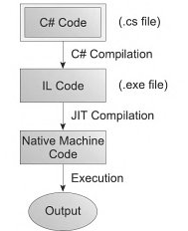
Execution of C# Program
Write source code in any editor (notepad, word pad etc.)
Save it with .cs extension (i.e, file_name.cs).
Open visual studio command prompt and go to the
directories containing your filename.
4. Compile the program by writing the command
csc file_name.cs
( c# compiler compile code and create an executable file
(IL code) by name file_name.exe
5. If the code is error free then execute the executable file by
file_name

Slide 11
ADDING COMMENT
C# PERMITS TWO TYPES OF COMMENTS
Single line comments : by using double backslash (//) symbol.
// this is an example of
//Multiple comments
//in C# Language
2. Multiple line comments:
Uses /* ………..*/ to write multiple line comments.
/* this is an example of
Multiple line
Comments in C# Language
*/

Slide 12
Using Aliases for namespace classes
System is a namespace and Console is a class. The using directive can be applied only to
Namespaces and can not be applied to classes therefore the statement is illegal
using System.Console;
To overcome this problem we used aliases for namespace classes.
using alias_name = class-name;
Example:
using A = System.Console;
Class Sample
{
Public static void main()
{
A.WriteLine(“Hello”);
}
}

Slide 13
Reading and Writing to Console
There are two ways to write to console:
a) Concatenation b) Place holder syntax (most prefer).
Ex.
using System;
namespace ConsoleApp7
{
class Program
{
static void Main()
{ int a;
System.Console.WriteLine("enter your first name");
string fname = Console.ReadLine();
string lname = Console.ReadLine();
System.Console.WriteLine("Hello " +fname +lname); //Concatenation method
System.Console.WriteLine("Hello {0} {1}",fname,lname); //place holder method
int.Parse(Console.ReadLine()); //Reading integer from Keyboard
System.Console.ReadLine(); // alternate method to fix the output screen
}
}
}

Slide 14
Using multiple classes
A program with two classes: only one class can have Main() method
class TestClass
{
public void fun()
{
Console.WriteLine("you are in second class");
}
}
class Program
{
static void Main(string[] args)
{
Console.WriteLine("you are in main methods");
TestClass test = new TestClass();
test.fun();
} }

